Slide 1
Stock Market Prediction USING RNNs
ME 781 PROJECT
TA Prateek Kumar - 213100075@iitb.ac.in
GROUP 27:
Hidhartha Shankar Das - 213040077 Oshin - 190110056
Dhanush S - 19D100006 Rohit Mandhyan - 20D170034
Adarsh Nagpure - 200110004

Slide 2
LSTMs and Encoder- Decoder RNNs
Data of the project comes from Yahoo Finance API implemented in code
Present Data Used Dow Jones Industrial Average (DJIA) Index
Link to the notebook: https://colab.research.google.com/drive/1QJOLYxsF43ActkeSUAe0e4Dx_p1uQ4Rl
https://colab.research.google.com/drive/1cbYIjHL7O1OUJ-_WOT0QSmKd2uRPuDYG

Slide 3

Recurrent Neural Networks
In the conventional feed-forward neural networks, all cases are treated as independent, i.e, when fitting the model for a particular day, there is no consideration for the stock prices of the previous days.
This dependency on time can be achieved by using Recurrent Neural Networks
They are networks with loops in them, allowing information to persist
A loop allows information to be passed from one step of the network to the next

Slide 4
The problem of long term dependencies
Recurrent Neural Networks work well when we are dealing with short-term dependencies
However, vanilla RNNs fail to understand the context behind an input. Some value that was outputted long before, cannot be recalled when making predictions in the present
They experience the problem of vanishing gradient when dealing with long term dependencies
This problem can be tackled very well using an improved version of RNNs called LSTM (Long-Short Term Memory Networks)

Slide 5
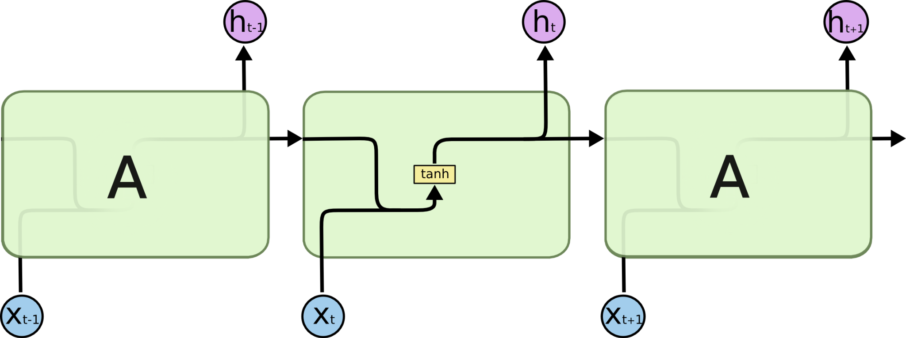

Long Short Term Memory Networks (LSTM)
LSTMs are special kind of RNNs that are explicitly designed to solve the problem of long term dependencies
In RNNs, there is a chain of repeating modules of neural network. This repeating module has a very simple structure, such as a single tanh layer.
LSTMs also have this chain like form, but the repeating module has a different structure. Instead of having a single neural network layer, there are four, interacting in a very special way
RNN Structure
LSTM Structure

Slide 6
Working of LSTMs
In LSTMs, information flows through a mechanism known as cell states. This way, LSTMs can selectively remember or forget things. The information at a particular cell state has three different dependencies.
These dependencies can be generalized to any problem as:
The previous cell state (i.e. the information that was present in the memory after the previous time step)
The previous hidden state (i.e. this is the same as the output of the previous cell)
The input at the current time step (i.e. the new information that is being fed in at that moment)
In order to control the flow of information, LSTMs use three types of gates:
Forget Gates to ignore irrelevant information
Memory Gates to choose which new data need to be stored in the cell
Output Gates to decide what will be yield out of each cell

Slide 7
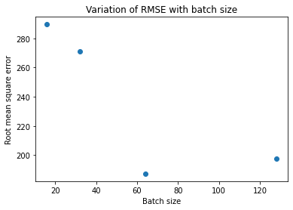
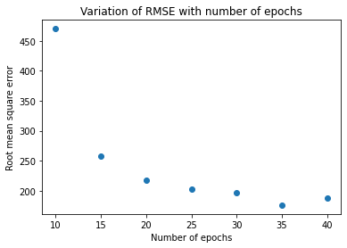
Implementation of LSTM
Hyperparameter tuning: Finding the optimum batch size (for gradient descent) and number of epochs which minimize the root mean square error
Optimum batch size = 64
Optimum number of epochs = 35

Slide 8
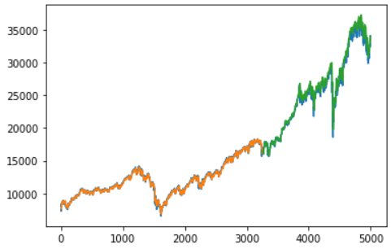
Performance of the model on test data
Orange Line- Training Dataset
Green Line- Validation Dataset
Blue Line- Actual Stock Price
Root Mean Square Error = $ 163.46

Slide 9
References:
https://www.ibm.com/cloud/learn/recurrent-neural-networks
https://arxiv.org/pdf/2101.03867.pdf
Reference: A Reinforcement Learning Based Encoder-Decoder Framework for Learning Stock Trading Rules by Mehran Taghian1 et al, 2021
https://www.ibm.com/cloud/learn/recurrent-neural-networks//www.ibm.com/cloud/learn/recurrent-neural-networks
https://colah.github.io/posts/2015-08-Understanding-LSTMs/
https://www.researchgate.net/figure/ACI-finance-actual-vs-predicted-values-for-Encoder-Decoder-LSTM-Model_fig7_352013154
https://www.ellis.ox.ac.uk/quant-finance-ml
https://www.youtube.com/watch?v=-e1BRsuOZ7o

Slide 10
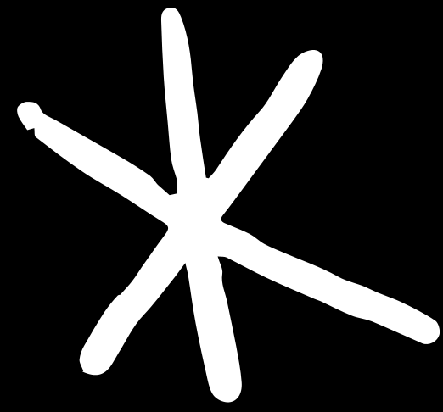

Group 27
THANK YOU!
Caution: Doesn't rollin' these models everywhere and everytime.

